Slide 1
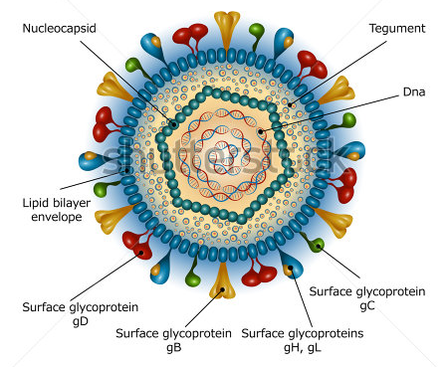
Herpesviridae Herpes Simplex Virus (HSV)
Dr. CHHAY Sokdalis

Slide 2
Objective
After this session the students should be able to:
List the characters HSV.
Describe the morphology of HSV.
Illustrate the different stages of multiplication of HSV.
Define the routes of transmission of HSV.
Recognize the target organs of infection with HSV (specifying type of virus responsible).
Describe the pathophysiology of HSV infection (pathogenic Power).
Determine the different stages in the evolution of HSV infection.
Describe the Clinical manifestations of HSV infection.
List the techniques for detecting HSV.
List active molecules for treatment HSV.

Slide 3
Plan
Characteristics of virus
Multiplication
Epidemiology
Pathogenesis and immunity
Clinical manifestations
Diagnostic virology
Treatment and prevention

Slide 4
Characteristics of virus
Characters of HSV:
Icosahedral capsid of 162 capsomers (6 proteins).
Envelope (nuclear membrane): glycoproteins 11 → viral attachment, fusion, entry and escaping immune control.
Tegument: space between envelope and capsid (viral proteins and enzymes that help viral replication upon initial infection).
HSV genome: large, DNA double-stranded linear 152 kbp (C + G = 68%).
Genetic information coding for 80 proteins.
Ubiquitous
Sensitive: acid, solvents, detergents, and drying.

Slide 5
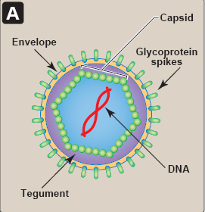
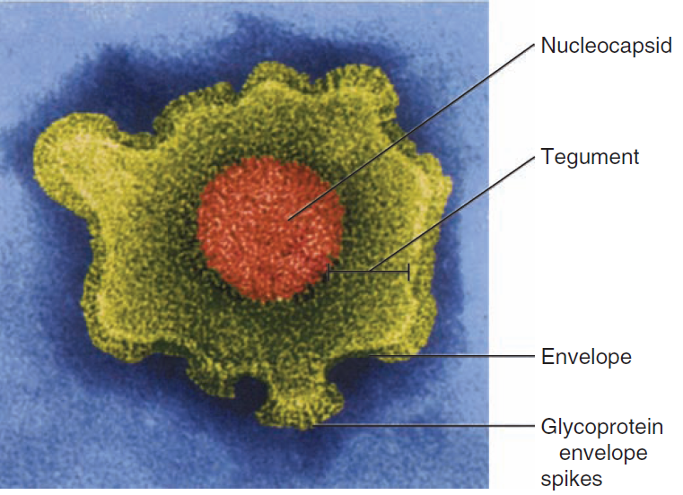
Characteristics of virus
Herpesviridae
Nucleic acid | Linear double-stranded DNA
Capsid | Icosahedral
Symmetry | Cubic
Peplos (envelope) | Present
Number of capsomeres | 162
Diameter virion | 150-200 nm
Molecular weight of NA | 150 Kbp
Familly | Herpesviridae (α subfamily)

Slide 6
Multiplication
In vitro: permissive cells (human diploid cell, monkey kidney cell and amniotic fluid).
In vivo: permissive cells (human)→ lytic infections (fibroblasts and epithelial cell) and latent infections (neurons).
Glycoprotein bind to glycosaminoglycans →Membrane fusion →nuclear pore→uncoating cellular enzyme.
Initiation of viral transcription (tegument protein, V16).
Transcription of viral genome and viral protein synthesis proceeds in a coordinated and regulated manner in following 3 phases:
Immediate early proteins (α): regulation of gene transcription and takeover of cell.
Early proteins (β): transcription factors and replication (DNA polymerase…).
Late proteins (γ): mainly of structural proteins (generated after viral genome replication has begun).

Slide 7
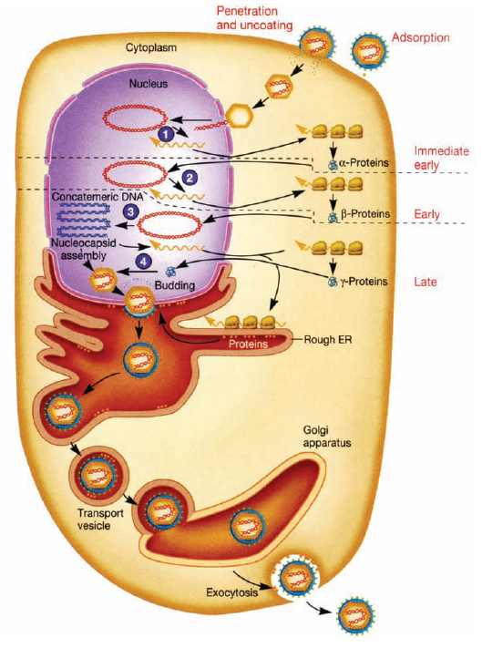

Slide 8
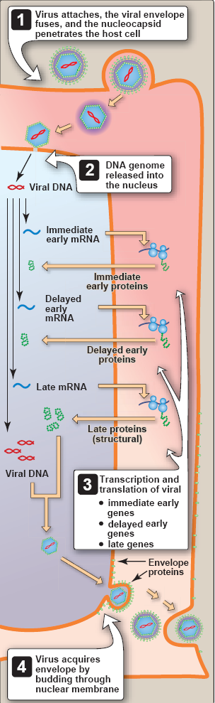
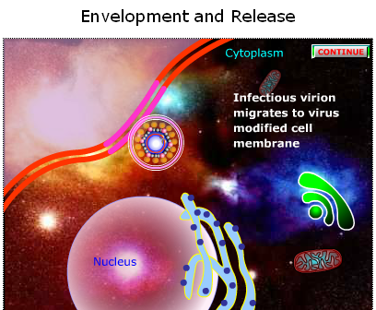
Multiplication
Assembly and release

Slide 9
Epidemiology
Viral reservoir: human
Disease/Viral Factors
Virus causes lifelong infection.
Recurrent disease is a source of contagion.
Virus may cause asymptomatic shedding.
Transmission: direct contact of mucosal tissue
Saliva, vaginal secretions, and by contact with lesion fluid (mixing and matching of mucous membranes).
Virus is transmitted orally and sexually and by placement into eyes and breaks in skin.
HSV-1 is generally transmitted orally; HSV-2 is generally transmitted sexually, but not exclusively.

Slide 10
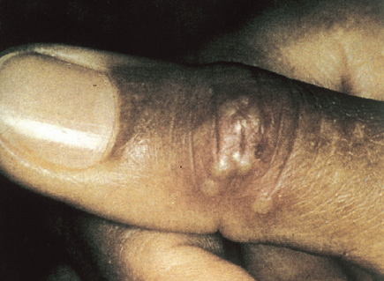
Epidemiology
Who Is at Risk? (worldwide)
Children and sexually active people are at risk for primary disease of HSV-1 and HSV-2, respectively.
Physicians, nurses, dentists, and others in contact with oral and genital secretions are at risk for infections of fingers (herpetic whitlow).
Immunocompromised people and neonates are at risk for disseminated, life-threatening disease.
HSV-1: oropharyngeal, mucosa and eye infection.
HSV-2: genital mucosa (below waist).

Slide 11
Pathogenesis
Acute Infections
Initially infect and replicate in mucoepithelial cells→lytic or productive infection at site of contact.
(PMN) infiltrate and a subsequent mononuclear cell infiltrate→ Development of multinucleated giant cells, ballooning degeneration of epithelial cells, focal necrosis, eosinophilic intranuclear inclusion bodies, and an inflammatory response.
Spreads→local sensory neurons→retrograde sensory ganglia that innervate site of infection.
Facial herpes: infects neurons in trigeminal ganglia.
Genital herpes: dorsal root or sacral ganglia.

Slide 12
Pathogenesis
Latent infection
Latent phase in organism: despite immune response
HSV-1 (oropharyngeal infection) → trigeminal ganglion (sensitive nerve).
HSV-2 (genital infection) → sacral ganglion.
LAT (Latency Associated Transcript)→miRNAs that serve as regulatory RNAs →alter host cell gene expression without expressing foreign proteins.
Active phase: UV, immunosuppression, cellular factor, sunlight, fever, excitement, emotional stress, and trauma (axonal injury)…
Reactivation→lytic replication→travels down neuronal axons, most often to a site near site of initial infection (inapparent or vesicular lesions (virions)) →Tissue damage (viral pathology +immunopathology)→heals without producing a scar.
CD8 T cells and IFN-γ →maintain HSV in latency.

Slide 13
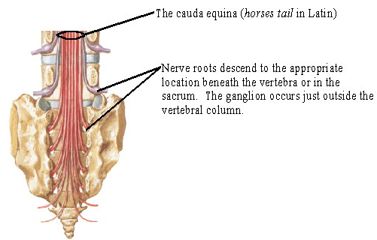
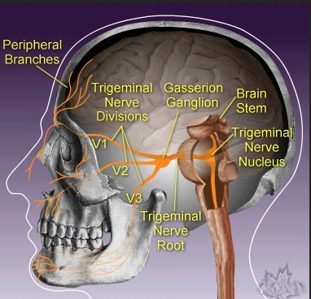
Pathogenesis
Sacral ganglion
Trigeminal ganglion

Slide 14
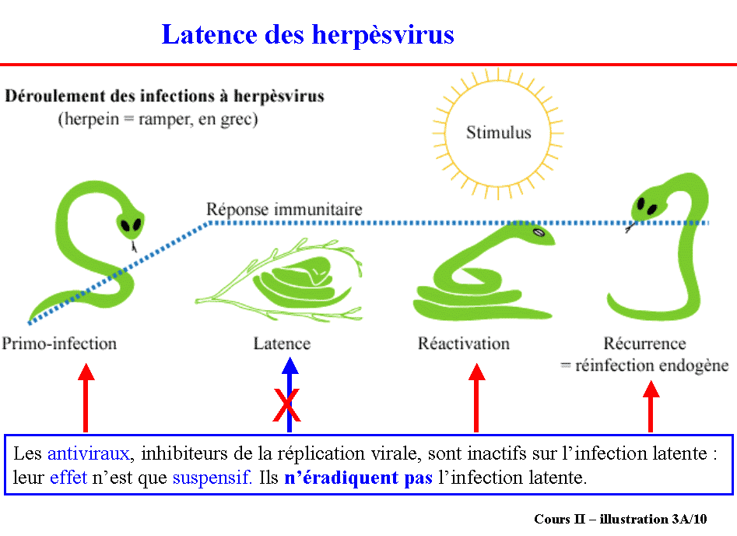
Pathogenesis

Slide 15
Immunity
Innate protections: interferon and natural killer (NK) cells→ limit initial infection.
TH1 associated and CD8 cytotoxic killer T-cell responses→ kill infected cells and resolve acute disease.
Immunopathologic effects of cell-mediated and inflammatory responses→major cause of disease signs.
Antibody directed against glycoproteins of virus neutralizes extracellular virus, limiting its spread, but is not sufficient to resolve infection.
Absence of functional cell-mediated immunity, HSV infection is likely to recur and be more severe, and may disseminate to vital organs and brain.

Slide 16
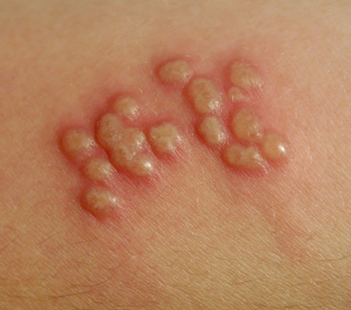
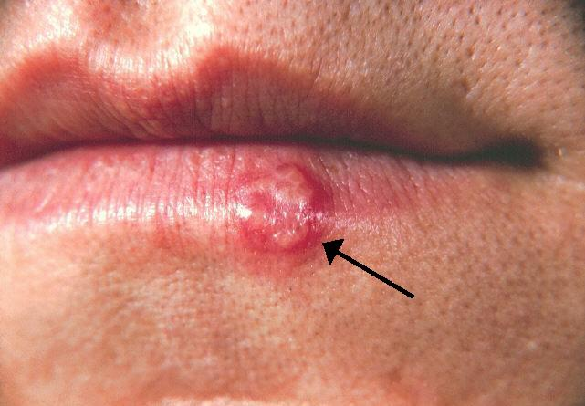
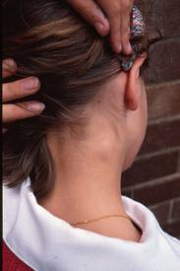
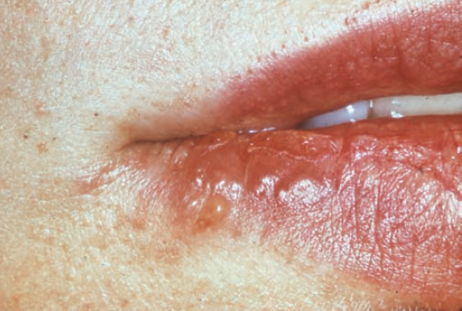
Clinical Manifestations
Clinical manifestation: HSV-1
Young children: Gingivostomatitis
Adult: Pharyngitis or tonsillitis
Vesicular skin lesions → ulcerated
Cervical adenopathy
Fever, malaise, myalgia
Feeding difficulties.
Vesicular skin lesion
Vesicular skin lesion

Slide 17
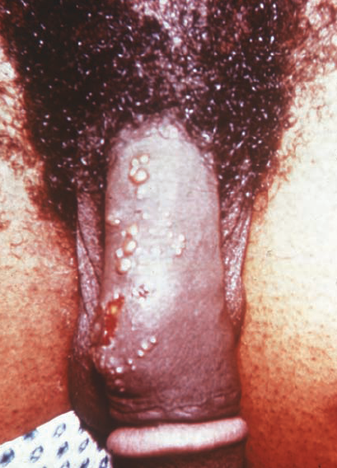
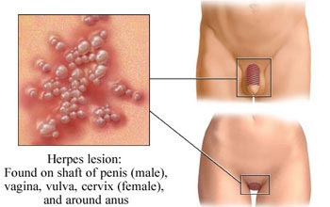
Clinical Manifestations
Clinical manifestation: HSV-2
Elementary lesion
Painful vesiculo-ulcerative lesions
Pustules
Ulceration
Systemic symptoms: fever, malaise, and myalgia
Dysuria
Inguinal adenopathy.

Slide 18
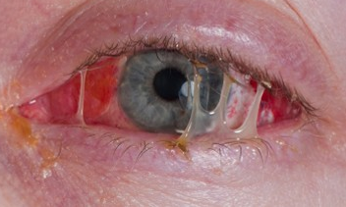
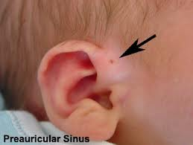
Clinical Manifestations
Eye infection
Mainly by HSV-1 (neonatal exception)
Keratoconjunctivitis
Infection in corneal
Pre-auricular adenopathy
Photophobia
Edema
Larmoiment
Retinitis → several years after herpes infection
Cause of blindness: corneal or retinal infection.
Central nervous system (CNS): encephalitis→untreated.
Keratoconjunctivitis

Slide 19
Clinical Manifestations

Slide 20
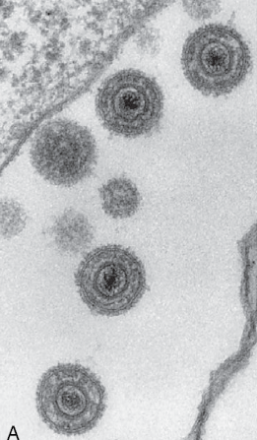
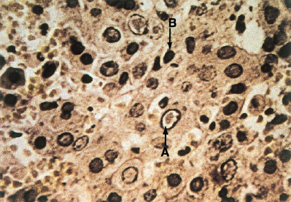
Diagnostic virology
Virus isolation: culture cellulaire → viral (reference method)
Sampling at site of infection: vesicle scraping, fluid, or genital swab.
Permissive cell: Vero, human diploid cell.
Culture time: 48h → > days.
Identification
Observation of CPE (syncytia, “ballooning” cytoplasm, and Cowdry type A intranuclear inclusions).
Electronic microscopy: family Herpesviridae.

Slide 21
Diagnostic virology
Immunological technique
Less sensible
Detection of Ag in a few hours.
Methods in molecular biology (PCR)
Detection of viral nucleic acid
No indication of infectious power
Neurological interest: CSF (replaced immunofluorescence analysis of a brain biopsy).
Indirect diagnosis: ELISA
Detect IgM, IgG
Interest: antibodies differentiate HSV-1 or -2, diagnosing a primary HSV infection and for epidemiologic studies.

Slide 22
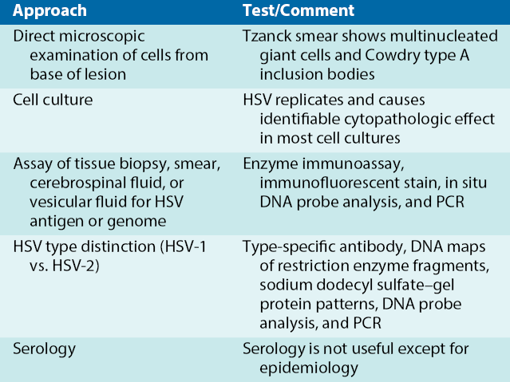
Diagnostic virology

Slide 23
Diagnostic virology
Indication of exams:
Diagnosis of primary infection:
Isolation: mucocutaneous lesions
Serology: IgM, IgG.
Herpes encephalitis
Interferon dosage in CSF
PCR of CSF before treatment
Comparative serology (primary infection or not).
Retinitis herpes
PCR of aqueous humor or vitreous.
Genital infection during pregnancy
Viral Culture: No known genital HSV.
Neonatal infection
Culture isolation or PCR.

Slide 24
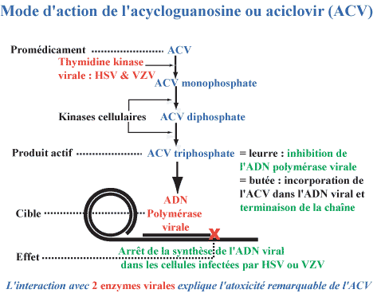
Treatment
Guanine analog, acycloguanosine (acyclovir), is selectively effective against HSV →active inhibitor of DNA synthesis only after initially being phosphorylated by HSV thymidine kinase.

Slide 25
Treatment
First Clinical Episode of Genital Herpes
Recommended Regimens*
Acyclovir 400 mg orally three times a day for 7–10 days
OR
Acyclovir 200 mg orally five times a day for 7–10 days
OR
Famciclovir 250 mg orally three times a day for 7–10 days
OR
Valacyclovir 1 g orally twice a day for 7–10 days
*Treatment can be extended if healing is incomplete after 10 days of therapy

Slide 26
Prevention
No vaccine
Limit close contact with an infected person (virus-shedding lesions and by safe sexual practice→condom).
Prophylactic therapy of mother and newborn with acyclovir.

Slide 27

Refereneces
Jean-Marie Huraux et al «Virologie» Université Pierre et Marie Curie 2006-2007.
Cynthia Nau Cornelissen, Bruce D. Fisher, Richard A. Harvey, Lippincott’s Illustrated Reviews: Microbiology. Third Edition. 2013.
Patrick R. Murray, Ken S. Rosenthal, Michael A. Pfaller. MEDICAL MICROBIOLOGY. 2016. 8th EDITION.
Kenneth J. Ryan, MD, C. George Ray. Sherris Medical Microbiology. 7th edition. 2018.

